Slide 1

Nursing Home Analysis
Reshmi Neelakandan
Viswajani Paladugu
Kursad Altayli
Gomathi Veluswamy
Notes:
Hello Ladies and Gentlemen, today we will talk about Nursing Home analysis. After Covid-19, we wondered that how many nursing homes there are all across US and how many Residents Died during this term and How many residents in Nursing homes died due to Covid-19. This presentation is being made by Reshmi, Viswajani, Me, Gomathi.

Slide 2

Overview
Goal of our project is to study Nursing Homes across United States and focus on one of the top ten states.
Number of Nursing homes across US
Display top 10 states by number of Nursing home.
Chose Pennsylvania to do detailed analysis.
COVID-19 deaths in Nursing Homes across US
Source of Data:
https://data.medicare.gov/data/nursing-home-compare?sort=alpha&tag=star%20ratings
https://www.health.pa.gov/topics/HealthStatistics/HealthFacilities/NursingHomeReports/Pages/nursing-home-reports.aspx
https://data.cms.gov/Special-Programs-Initiatives-COVID-19-Nursing-Home/COVID-19-Nursing-Home-Dataset/s2uc-8wxp/data
https://www.prb.org/which-us-states-are-the-oldest/
Notes:
The goal of this project is to evaluate and study Nursing Homes across US. And Focus on one of the top ten states which has more Nursing Homes.
There are some Nursing Homes which are Best Rated, and Worst Rated. We also analyzed how those Nursing homes are rated and displayed top 10 states by number of Nursing Homes. Furthermore,one of the top states which is Pennslyvania which we chose to do detailed analysis.
We used different data and most of the data from Medicare.gov website. We cleaned them, narrowed them and merged them with other Data. For example, we got ratings from one data, and we obtained nursing homes only in PA and merged them with Covid-19 Deaths data to see how many residents died due to Covid-19 in best and worst rated Nursing Homes
The reason why we chose Pennyslyvania is 1) One of the top ten States across US which has more Nursing Homes
2) Reached better and reasonable data related to Nursing Homes Rates and Covid-19 Deaths
3) The state which is closest one among other top ten states.

Slide 3

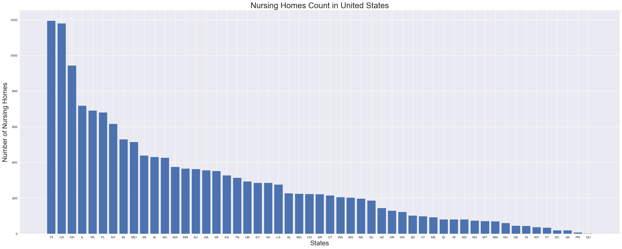
Nursing Home by State
Bar chart below shows the total number of nursing homes by state in US.
Texas has the highest number of nursing homes in US

Slide 4
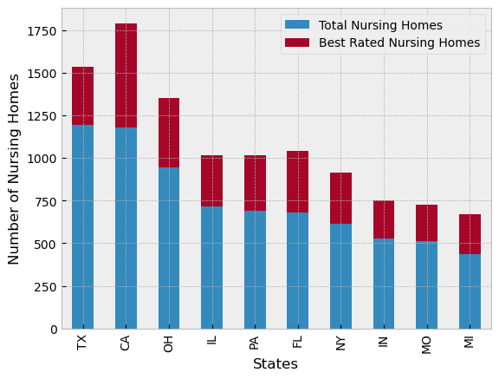
Best Rated Nursing Homes
Following visualization shows Top 10 States with Best Rated Nursing Homes
Texas, California, Ohio, Illinois and Pennsylvania are the top 5 States with best rated Nursing Homes

Slide 5

Pennsylvania Nursing Homes – Deep dive
Acquired Nursing Home data for the state of Pennsylvania to do the following drill-down analysis
Best Vs Worst Rated across PA
Residents in Nursing Home by Age-wise, Gender
Interesting fact of centenarians in PA
Different ratings influencing overall nursing home rating.
Nursing home count by population ages 65+ across US
Correlation between nursing home rating and COVID-19 deaths

Slide 6
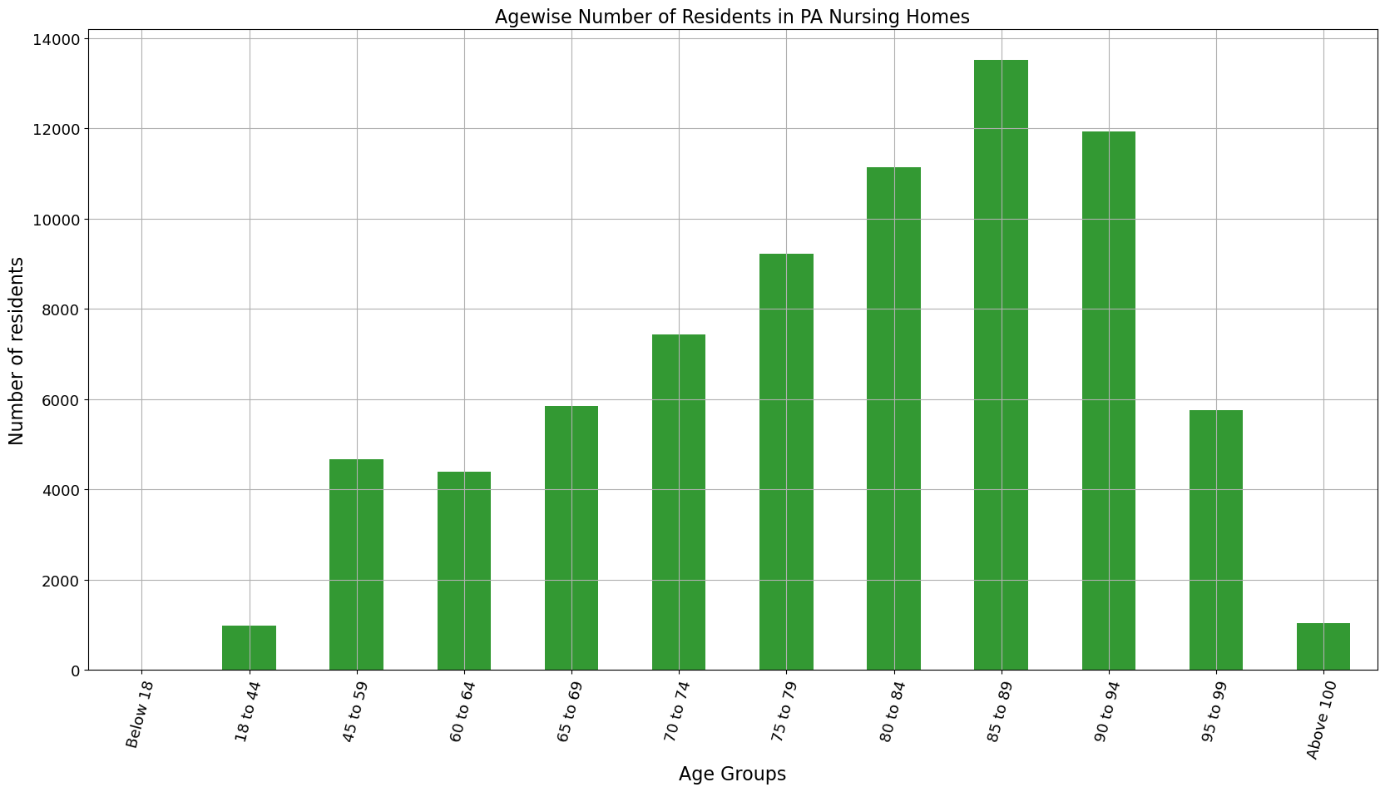
Age-wise comparison of Residents
In PA, around 18% of the total residents in Nursing Homes are of age group 85 to 89, followed by 16% of age group 90 and 95

Slide 7
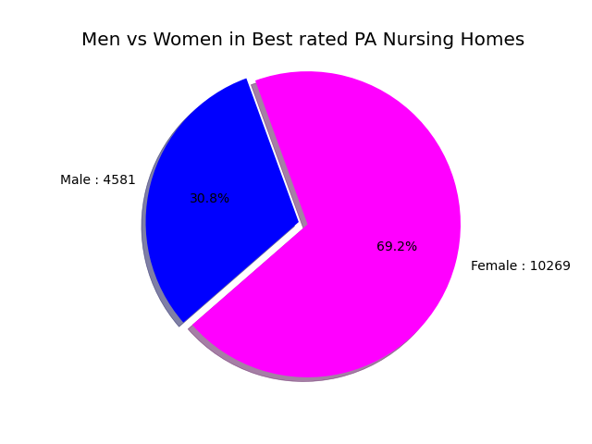
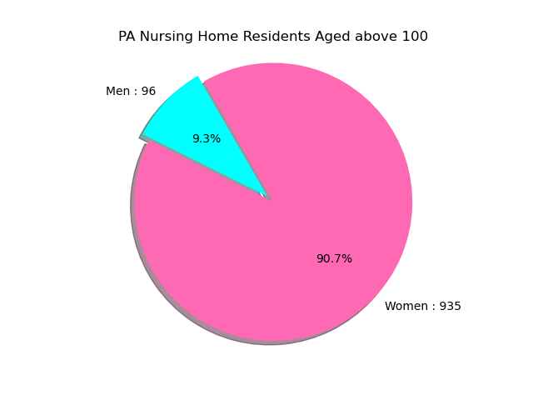
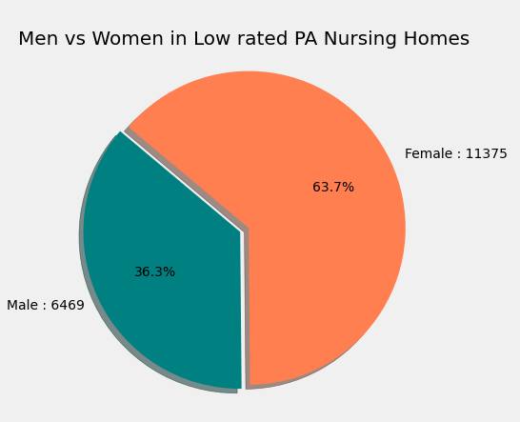
Women Power ☺
Overview
Irrespective of the Nursing Home’s rating, ratio of women living in Nursing home is 40% more when compared to Men.
In US, 82,000 people are of age 100 and over. 16,000 Male and 66,000 Female

Slide 8
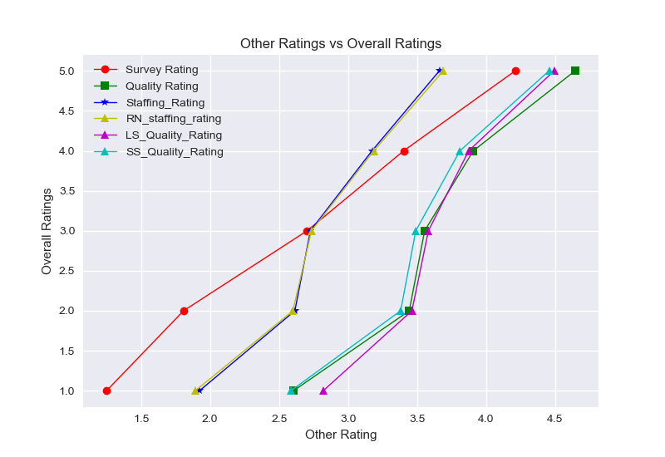
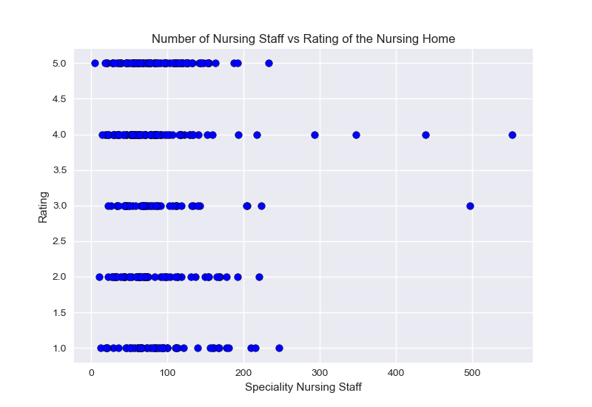
Nursing Homes Ratings
Nursing homes with more nurses, orderlies tend to be slightly better rated.
Over-all rating is an average of long-stay /short stay rating, survey rating, skills
Overview

Slide 9
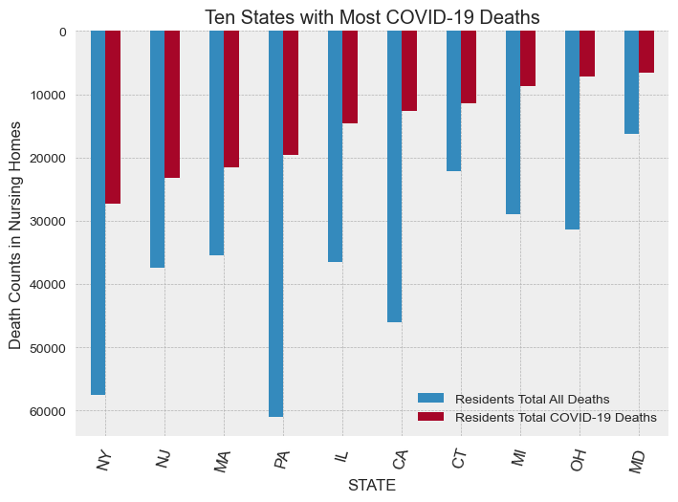
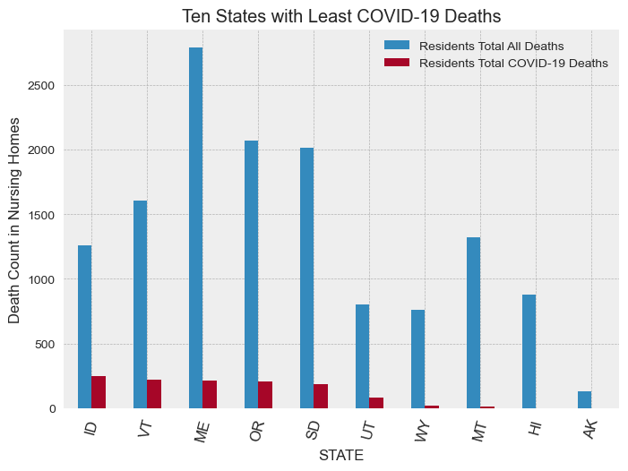
Top ten states with most and least COVID19 deaths
Notes:
After deciding the worst and best rated Nursing Homes based on age of Residents, Gender of Residents, Staff and Long and Short stay, We focused on the number of deaths and the number of Covid-19 deaths across US and Pennyslvania the period between January 1 and July 16 ,2020.

Slide 10
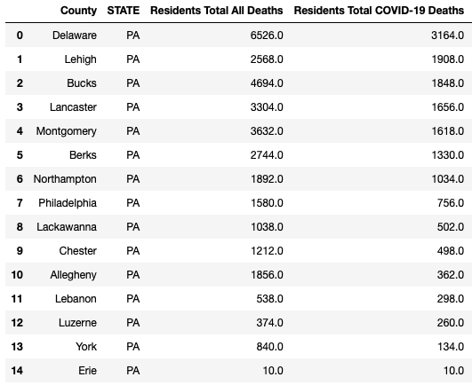
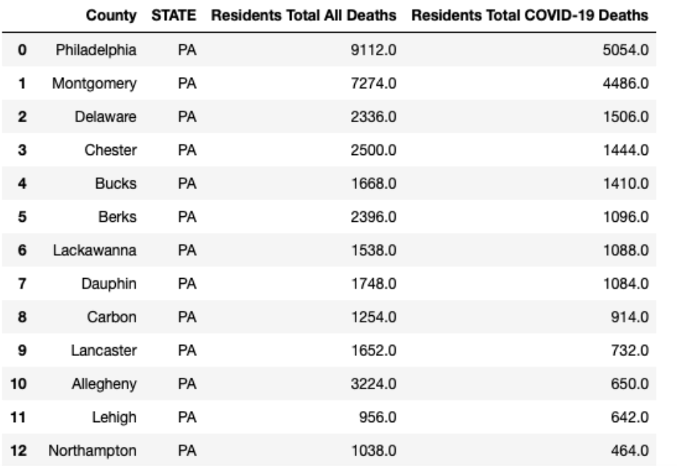
COVID deaths comparison : Densely vs Sparsely populated Nursing Homes
Notes:
After displaying the number of Covid-19 deaths across Us, we devoted ourselves to the residents who died at Nursing Homes in each counties of Pennslyvania. There are 2 tables over here which are divided by ratings. We grouped them as a Best Rated and Worst rated Nursing Homes in each counties of Pennslyvania. On the left chart, you will see the number of Deaths at Best rated Nursing Homes located in each counties . On the right chart, you will see the number of Deaths at Worst rated Nursing Homes in each counties. In the next slide you will displayed their laocations by using Gmaps.

Slide 11
COVID deaths in PA-Counties : Best rated nursing homes

Slide 12
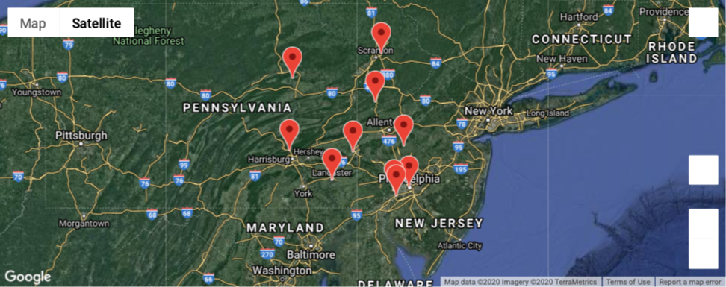
COVID deaths in PA-Counties : Worst rated nursing homes

Slide 13
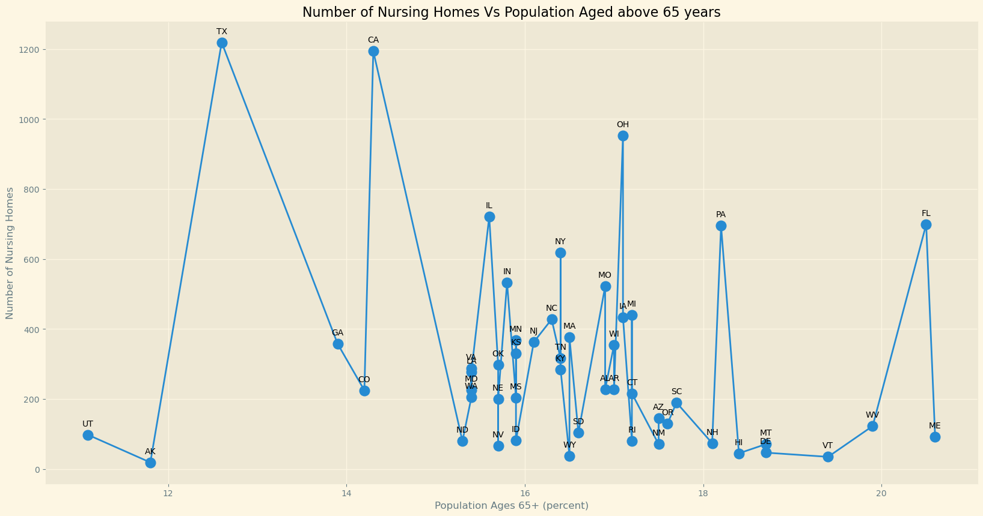
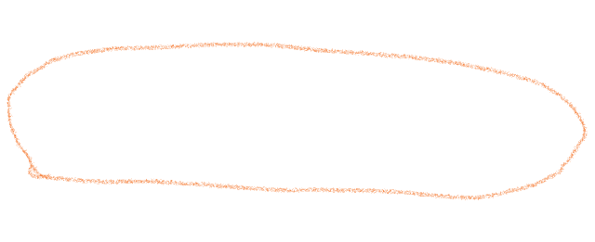
Shows the need for more nursing homes in states like NH, VT, ME with greater aging population.

Slide 14
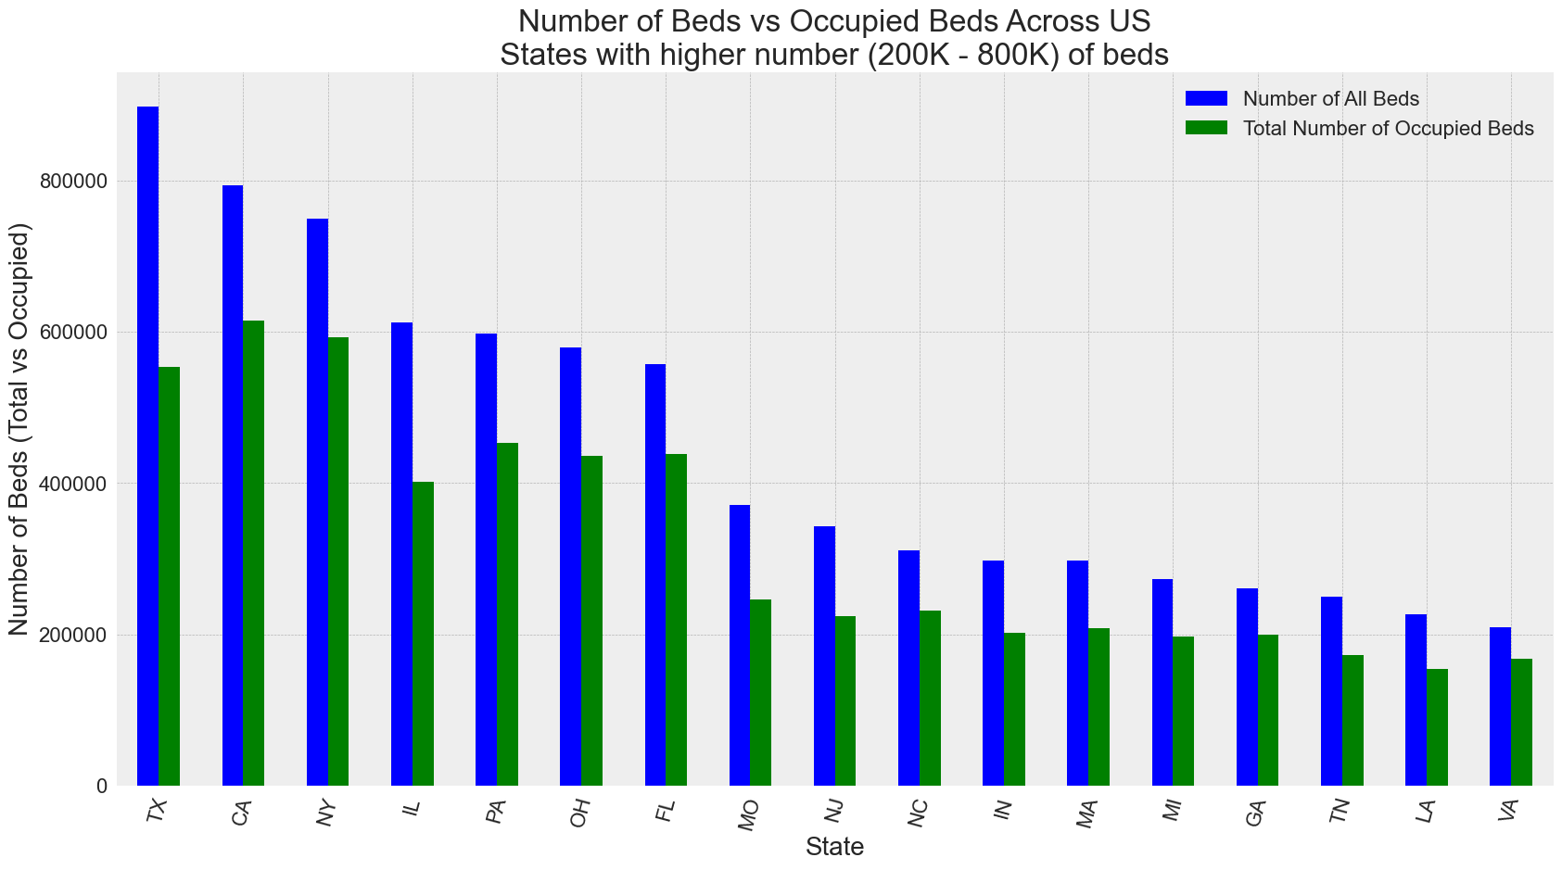
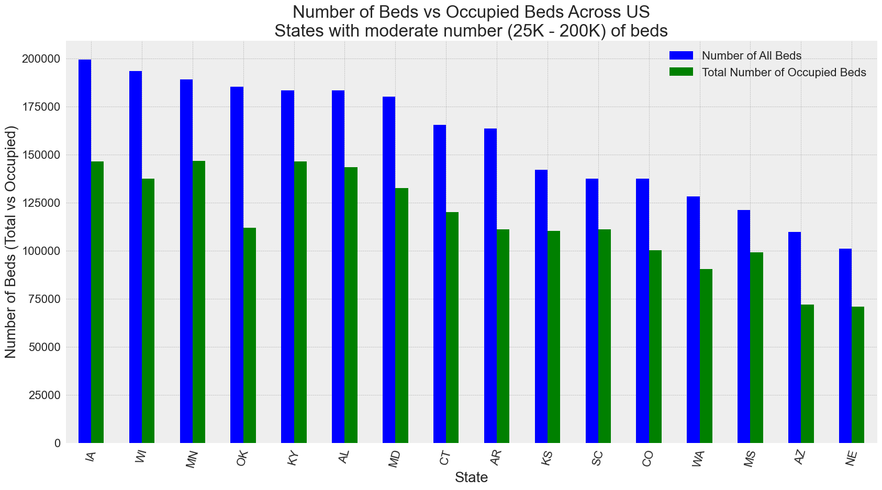
Available Bed count Vs Occupied count

Slide 15
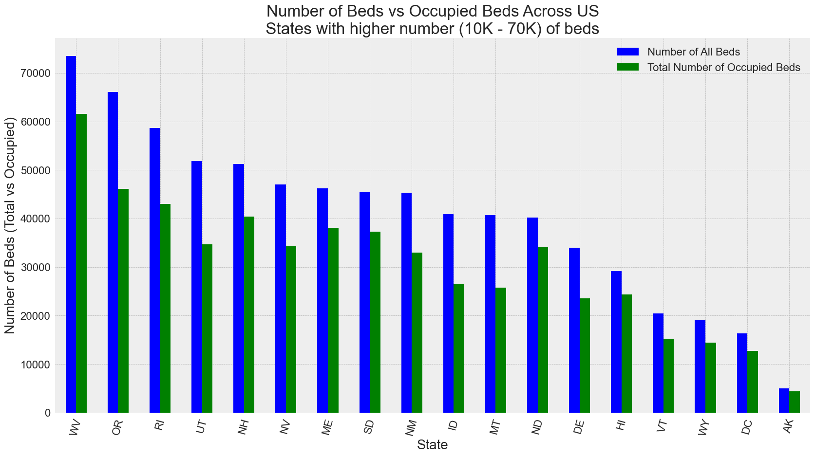
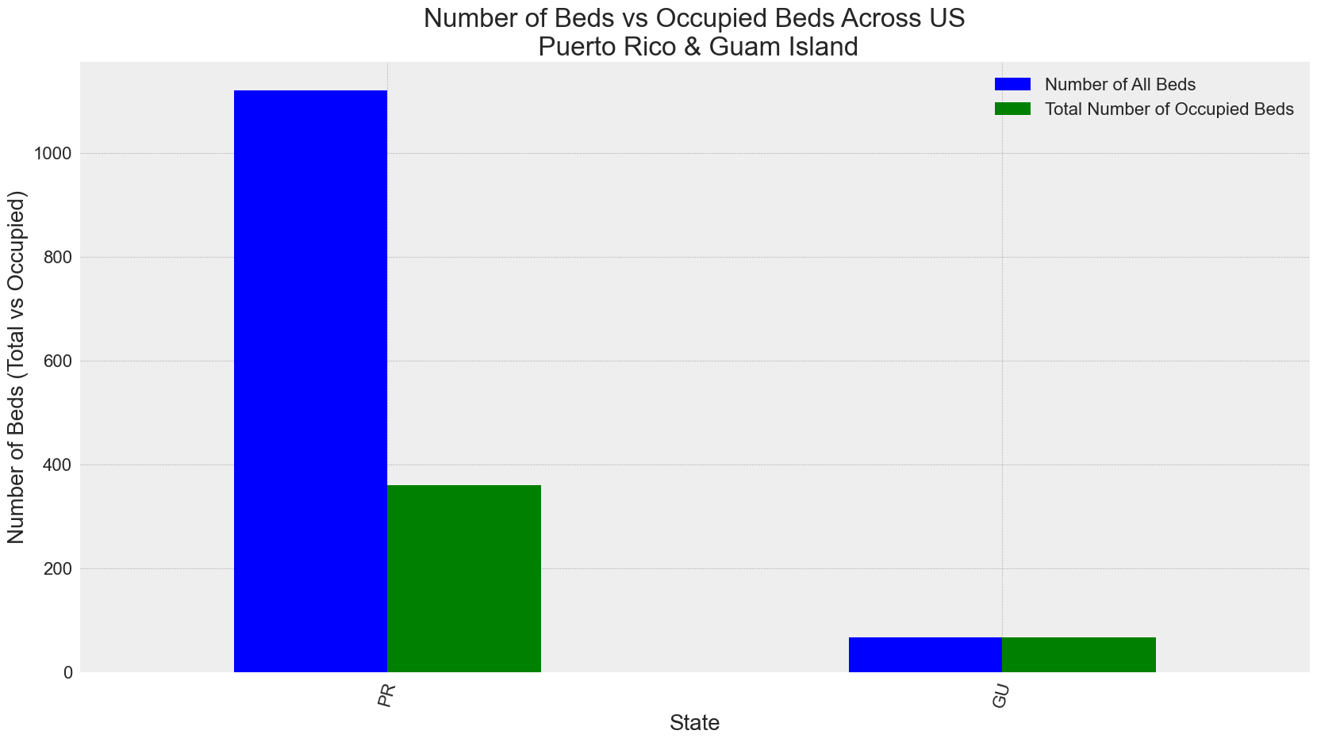

Slide 16
Predictions & Conclusion
As we age, daily activities tend to become more challenging, especially if chronic health conditions like diabetes, arthritis are also present.
Based on Medicaid & Medicare services report, In US
33.8% of residents in Nursing Homes were 85 to 94 years old, 26.4% were 75 to 84 years old and 16.5% were 65 to 74 years old.
Ratio of Women vs Men living in Nursing Home is 7:3
From our analysis, we strongly believe that nursing homes in some states with greater populations are crowded.
If the nursing home needs increase by 5% then the already crowded Nursing Homes are not equipped to provide the care our seniors require. Not to mention if another pandemic like the one we are facing now strikes again.
In the current situation we see that the nursing homes with more people show more deaths due to COVID than the ones with fewer residents.
In Nursing Homes across US, an average of 80% Beds are occupied leaving shortage of Beds if needed (also if there is a wave 2)

Slide 17
Q&A

